Slide 1
In-Service Training Programme and Toolkit for Validation of Skills Part A: Building the digital pedagogic skills for VET tutors Module D: WebQuests as learning frameworks!

Slide 2
A
Introduction
about the topic WebQuests as learning frameworks
B
Training phase
Small group work to the topic WebQuests as learning frameworks

Slide 3
A: Introduction to the topic WebQuests as learning frameworks

Slide 4
A1: What is a WebQuest?

Slide 5
What is a WebQuest?
„WebQuest is an inquiry-oriented activity in which students get all information from the web. Teachers provide their students with the documents that include links to websites to use the information, according to the activity. “
Abuhasnah, R. (2015): Examples of Webquests. https://www.edutopia.org/discussion/examples-webquests-science

Slide 6
What is a WebQuest?
WebQuests were invented by Bernie Dodge in 1995 from San Diego State University. According to him a WebQuest is an “inquiry-oriented activity in which some or all of the information that learners interact with comes from resources on the Internet”.
Dodge, B. (1997). Some thoughts about WebQuests. Retrieved August 15, 2003, from the WebQuest Homepage, San Diego State University: http://webquest.sdsu.edu/about_webquests.html

Slide 7
What is the purpose of a WebQuest?
“The purpose of using WebQuest is to encourage students to use information rather than gathering it and participate in meaningful classroom discussions.”
Abuhasnah, R. (2015): Examples of Webquests. https://www.edutopia.org/discussion/examples-webquests-science

Slide 8
What is the objective of WebQuests?
“The objective of the inquiry-baes online learning activity is “to promote ´transformative´ learning outcomes, accomplished through the reading, analysis, and synthesis of online resources.”
Fernandez, S. / Steward, T. / Hill, E. (2022): WebQuests in Online Learning. http://www2.hawaii.edu/~erikhill/learningobjects_webquest/index.html

Slide 9
Example: The WebQuest Plants Life?
Have a look at http://urbanext.illinois.edu/gpe/index.cfm
Do you see a difference to the WebQuest about Mitosis?
Have a look at http://www.differencebetween.net/science/difference-between-animal-mitosis-and-plant-mitosis/
http://urbanext.illinois.edu/gpe/index.cfm
http://www.differencebetween.net/science/difference-between-animal-mitosis-and-plant-mitosis/

Slide 10
A2: Use and Design of WebQuests!

Slide 11
Reasons to use and design WebQuests:
Bringing contemporary ideas into the classroom
Evaluating history, topics or events
Creation of a product
Dealing with authentic life situations
Foster motivation and imagination
Fernandez, S. / Steward, T. / Hill, E. (2022): WebQuests in Online Learning. http://www2.hawaii.edu/~erikhill/learningobjects_webquest/index.html

Slide 12
Design I: Tasks for learners within a WebQuest:
Retelling tasks
Compilation tasks
Journalistic tasks
Persuasion tasks
Design tasks
Creative production tasks
Consensus building tasks
Mystery and detective tasks
Fernandez, S. / Steward, T. / Hill, E. (2022): WebQuests in Online Learning. http://www2.hawaii.edu/~erikhill/learningobjects_webquest/index.html

Slide 13
Design II: What to use in a WebQuest:
Use commercial and non-commercial websites
Create an own website or a blog (e.g. with blogger.com) or a MOOC (e.g. with MOOCit.de) to provide the learners with the setting, the problem and the tasks.
You can also create own website with individual information to make sure the necessary information is available for the learners

Slide 14
Example:
https://web.archive.org/web/20120603233249/http://kathyschrock.net/webquests/FOULKE/rmindex.htm

Slide 15
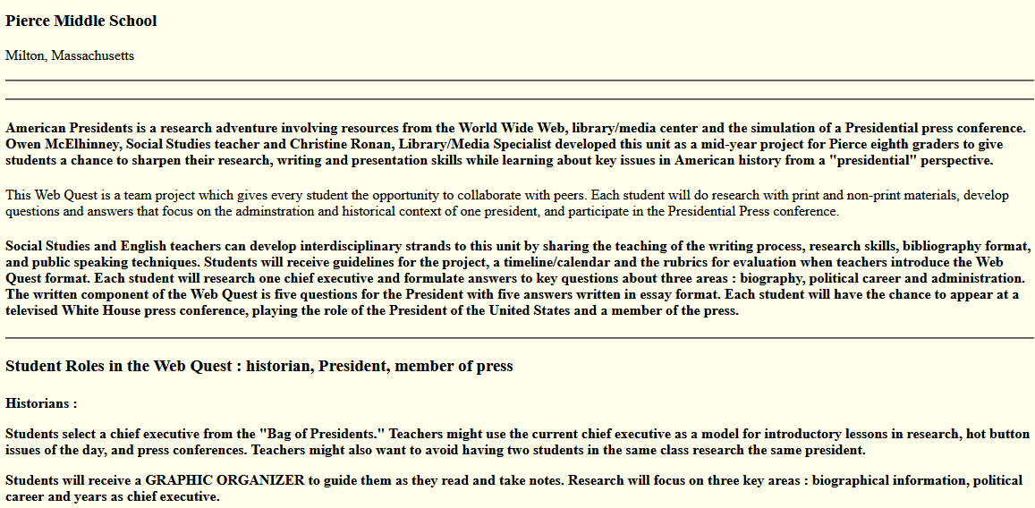
Example:
https://web.archive.org/web/20130615150435/http://kathyschrock.net/webquests/RONAN/index.htm

Slide 16
Example:
https://web.archive.org/web/20130615150435/http://kathyschrock.net/webquests/RONAN/index.htm

Slide 17
What are typical tasks in a WebQuest?:
Mathematic tasks, Retelling tasks, Coordinated tasks
Compilation tasks, Persuasion tasks, Design tasks
Presentation tasks, Categorisation tasks, Negotiation tasks
Check tasks, reporting tasks, consensus building tasks

Slide 18
A3: How to create a WebQuest?

Slide 19
Steps of WebQuest Design I: .
Introduction The introduction raises awareness of a topic. Due to the authenticity of the WebQuest it should arouse curiosity and the desire to get more information in the students:
Task and problem presentation Tasks and/or problems are presented clearly and precisely. If necessary they can be supplemented by student suggestions. However, purely reproductive tasks should be avoided.

Slide 20
Steps of WebQuest Design II: .
Information on work organisation In addition to the tasks, information about the work organization is provided:
suggestions for the individual work steps, the social form (group or individual work), division of an overall task into individual subtasks, basic rules, available time, etc.
Overview on material and links A pre-selection of links is made available. This enables the students to obtain information from the Internet, which contributes to the solution of the task or problem. This is time-saving. In addition, references to further literature, other materials that are available, for example, in a library, can be provided.

Slide 21
Steps of WebQuest Design III: .
Evaluation information Every WebQuest should be evaluated. Self-evaluation by the students (reflection on their own work process and the quality of the results) is of great importance. If possible, a (written) feedback on their work provided by teacher is helpful. Evaluation criteria can be disclosed to the students.
Summarising elements A summary of experiences and encouragement to reflect on the procedure, the expansion or generalization is important.
The can be a focus on ´lessons learned´ and on ´embedding in one's own world of knowledge´.
Presentation The presentation of the result and sharing ideas helps to get a general impression of the works done.

Slide 22
Pedagogical plus: WebQuests –a learner-centered approach
WebQuests are an opportunity to work in a learner-centered manner in the classroom and to use computers and the Internet sensibly.
The prerequisite, however, is that the teachers deal with the underlying aspects of learning theory at least to some extent.
WebQuests can be seen as building blocks for another lesson.

Slide 23
Elements of WebQuest Creation
Technical Knowledge
Pedagogical Knowledge
Web Editing
Scaffolding
See similar ideas at https://strategiesforspecialinterventions.weebly.com/webquest.html
Searching on the internet
Collaboration and cooperation
Creating links and forms
Constructivism

Slide 24
What sort of knowledge do you need to create a WebQuest?:
Technical knowledge
Scientific knowledge
Programming knowledge
Pedagogical knowledge

Slide 25
A4: The role of the teacher/trainer

Slide 26
Role of teachers/trainers
1. Designer of the WebQuest
2. Researcher and Organiser
3. Information provider
4. Providing hints
5. Debriefing mentor
6. Evaluator
7. Summarising and helping to find conclusions

Slide 27
Own educational escape rooms
For own educational escape rooms you can easily use a) a website e.g. designed with WordPress, b) ZOOM or another conferencing tool where you an display a presentation c) Google Forms or google slides

Slide 28
Educational escape room design steps
“Choose a topic
Choose an end goal (the big problem to solve — using the breadcrumbs from the small puzzles)
Set the scene
Decide on topics of the small puzzles that participants will solve (and the breadcrumbs they will earn by solving them)
Create the small puzzles
Create answer sheets and/or answer keys”
Learning Hypothesis (2023): https://learninghypothesis.com/how-to-create-a-digital-escape-room/

Slide 29
B. Training phase
work session in small groups

Slide 30
Task 1
Go to Create WebQuest: https://www.createwebquest.com/ Sign up and create a short WebQuest on a topic. You are free to select the topic.
You have 60 minutes. Please, collaborate with another person.
Afterwards, everyone should share ideas and show your WebQuest in a short presentation.

Slide 31
Task 2
Have a look at https://www.createwebquest.com/life-martin-luther-king-jr Discuss with another person the pros and cons of this WebQuest. Create a pro/con list.
You have 45 minutes. Please work on in a team.
Afterwards, everyone should share the impressions on the basis what you all wrote down and present your pro/con lists.

Slide 32
Congratulation!
You mastered module D on WebQuests in education!

