Slide 1
In-Service Training Programme and Toolkit for Validation of Skills Part B: models for the identification, recognition
and communication of transversal skills Module B: Models for the recognition of transversal skills

Slide 2
A
Introduction
About the topic Models for the recognition of transversal skills
B
Training phase
Group work Involving individuals in their skills’ recognition process

Slide 3
A: About the topic Models for the recognition of transversal skills

Slide 4
A1: Who are the actors in a skills’ recognition process?

Slide 5
Who are the actors in a skills’ recognition process?
The participants in a skill’s recognition process can vary depending on the specific context and purpose of the recognition process. However, there are some common themes for participant involvement, which will be presented in the next slide.
https://unesdoc.unesco.org/ark:/48223/pf0000374905

Slide 6
Who are the actors in a skills’ recognition process?
Competence holder
Assessor/ Evaluator
Employer/ Manager
Professional/ Body
Trainer/ Educator
Peer group
Relevent stakeholders

Slide 7
Who are the actors in a skills’ recognition process?
Competence holder: The person who possesses the skills and knowledge that is being recognised.
Assessor/Evaluator: The person or group responsible for assessing and evaluating the competence of the holder. They typically have the expertise and qualifications to make judgments about the competence being assessed.
Employer/Manager: The person or organisation that may have initiated the recognition process and has an interest in the skill being recognised. They may also provide evidence of the holder's work experience.
https://unesdoc.unesco.org/ark:/48223/pf0000374905

Slide 8
Who are the actors in a skills’ recognition process?
Professional body: A regulatory or industry-specific body responsible for setting standards for the profession or industry in which the competence is being recognised.
Trainer/educator: The person or organisation that provided training or education to the competence holder.
Peer group: Colleagues or other professionals who can provide feedback on the holder's skills and knowledge.

Slide 9
Who are the actors in a skills’ recognition process?
Relevant stakeholders: Other individuals or groups who have an interest in their competences being recognised, such as customers or suppliers.

Slide 10
A2: Stages of a skills recognition process

Slide 11
Stages of a skill’s recognition process
The stages of a skill’s recognition process can vary depending on the specific context and purpose of the recognition process. However, some common stages are presented in the next slide. Additionally, some processes may involve additional stages, such as opportunities for further development.
www.anqep.gov.pt/np4/753.html

Slide 12
Stages of a skill’s recognition process
Initial assessment: This involves an initial evaluation of the holder's skills and knowledge to determine their level of proficiency.
Evidence gathering: This stage involves gathering evidence to support the holder’s evidence of skill. This may involve collecting work samples, certifications, references, and other documentation.

Slide 13
Stages of a skill’s recognition process
Evaluation: This stage involves evaluating the evidence collected to determine whether the skill holder meets the required standards for the skill. This may involve assessments, interviews, or other methods of evaluation.
Feedback and reflection: This stage involves providing feedback to the skill holder on strengths and areas for improvement. The skill holder may also reflect on their own performance and identify areas for further development.

Slide 14
Stages of a skill’s recognition process
Certification or recognition: This stage involves awarding a certification or recognition to the skill holder if they have met the required standards for the skill. This can involve issuing a certificate or badge or adding a qualification to the skill holder's resume or professional profile.
Review and renewal: This stage involves periodically reviewing the holder's skills and knowledge to ensure they continue to meet the required standards for competence. This may involve re-certification or renewal of the recognition.

Slide 15
A3: Tools to support the assessment of transversal skills

Slide 16
Tools to support the assessment of transversal skills
There are various tools that can support the assessment of competences. Assessments may involve the use of multiple tools to provide a more comprehensive view of the holder’s skills. Next are presented some examples of assessment tools.
https://worldweather.wmo.int/tt_cat/systems.php

Slide 17
Tools to support the assessment of transversal skills
Self-assessment tools: These tools allow competence holders to assess their own skills and knowledge against a set of criteria. Self-assessment tools can be useful for providing a starting point for further assessment and identifying areas for improvement.
Standardised tests and assessments: These tools use standardised measures and procedures to assess skills in a particular area.

Slide 18
Tools to support the assessment of transversal skills
Performance assessments: These tools are used to assess skills by observing the competence holder when performing a task or job. Performance assessments can be useful for evaluating practical skills and knowledge in a real-world context.
Portfolios: Portfolios are collections of evidence that demonstrate the holder's skills and knowledge. Portfolios can include work samples, certifications, and other documentation, and can be useful for providing a comprehensive view of the holder’s competences.

Slide 19
Tools to support the assessment of transversal skills
Peer evaluations: Peer evaluations involve the assessment of competence by colleagues or other professionals in the same field. Peer evaluations can provide valuable feedback and insights into the holder’s skills from a different perspective.
Interviews: Interviews can be used to assess competence through the questioning of the competence holder on their knowledge, skills, and experience. Interviews can be useful for evaluating transversal skills as well as knowledge and expertise.

Slide 20
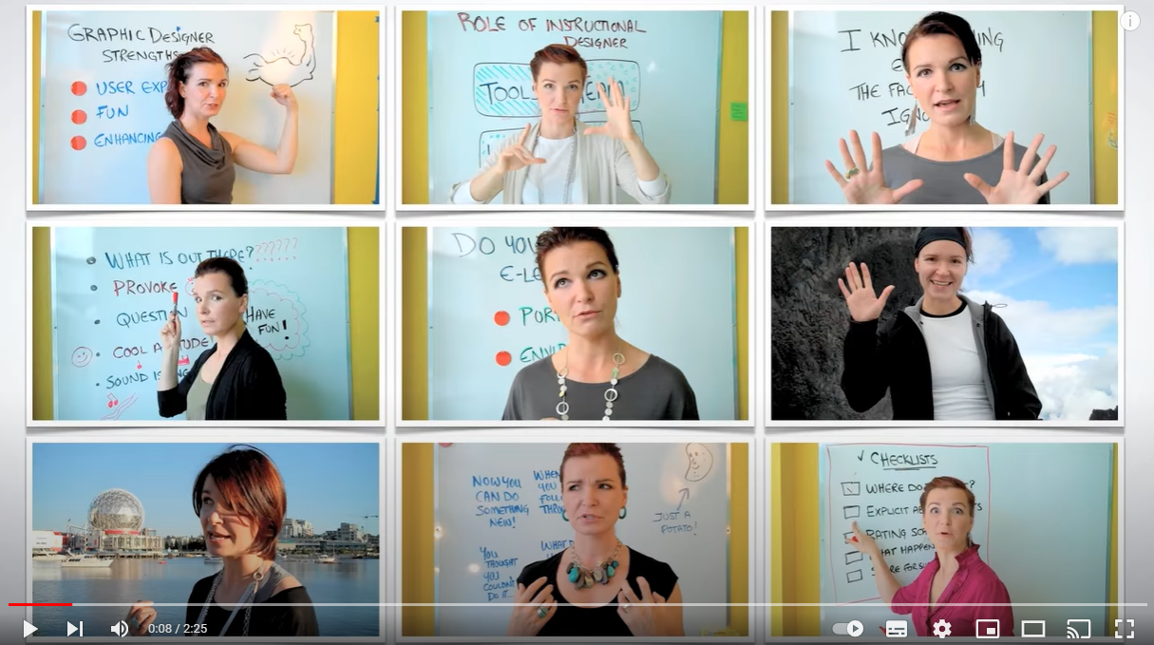
Assessment tools - Competence skills assessment
www.youtube.com/watch?v=YPpBAHCUJcc

Slide 21
A4: Matrix for the recognition of transversal skills

Slide 22
Matrix for the recognition of transversal skills
On the next slide there is a presentation showing an example of a matrix for the recognition of the 10 transversal skills featured in INTERFACE project, which can be used to evaluate and recognise a person’s transversal skills.
www.valamis.com/hub/skills-matrix

Slide 23
Matrix for the recognition of transversal skills
Skill | Level 1 | Level 2 | Level 3
Digital literacy | Demonstrates basic computer skills to use common software. | Adapts to new digital tools and platforms and can effectively use technology for communication and collaboration. | Uses advanced digital tools to create innovative solutions and improve processes.
Entrepreneurial spirit | Demonstrates creativity and innovation in work. | Identifies and capitalises on new opportunities for growth and development. | Successfully launches new ventures or initiatives and inspires and mentors' others to do the same.
Critical and creative thinking | Can analyse information and make informed decisions. | Can evaluate complex information and draw insights. | Can develop and implement data-driven strategies.
Leadership | Can lead and motivate a team. | Can develop and implement strategic plans. | Can inspire and lead organisational change.
Innovation | Can generate new ideas and approaches. | Can apply creativity to solve complex problems. | Can innovate and develop new products or processes.

Slide 24
Matrix for the recognition of transversal skills
Skill | Level 1 | Level 2 | Level 3
Problem solving | Can identify and analyse problems. | Can develop and implement effective solutions. | Can design and manage complex problem-solving processes.
Teamwork | Can work collaboratively with others to achieve goals. | Can lead collaborative efforts to achieve goals. | Can manage complex collaborative projects.
Work ethic | Demonstrates reliability and punctuality in work. | Takes initiative to improve work processes and efficiency. | Exceeds expectations, goes above and beyond, and sets an example for others.
Communication | Can effectively convey information to others. | Can adapt communication style to different audiences. | Can use communication skills to resolve conflicts.
Inter-generational relationships | Demonstrates respect and empathy for people of different generations. | Proactively seeks opportunities to learn from and collaborate with people of different generations. | Builds meaningful relationships and bridges between people of different generations.

Slide 25
A5: Analising transversal skills based on evidence

Slide 26
Analising transversal skills based on evidence
Analysing transversal skills based on evidence involves collecting and evaluating data that demonstrates a person's competences in a specific skill area. On the next slide there are some steps you can follow to analyse transversal skills based on evidence.
www.oecd-ilibrary.org/social-issues-migration-health/the-recognition-of-prior-learning_2d9fb06a-en
x

Slide 27
Analising transversal skills based on evidence
Define the skill: Clearly define the skill you want to analyse, including specific behaviours that demonstrate the skill.
Collect evidence: Gather evidence that demonstrates the person's competence in the defined skill. Evidence can come from a variety of sources, such as performance evaluations, self-assessments, work samples, and feedback from supervisors or colleagues.
Evaluate the evidence: Analyse the evidence you have collected to determine the person's level of competence in the defined skill. Look for patterns and trends in the data that suggest strengths and weaknesses.

Slide 28
Analising transversal skills based on evidence
Identify gaps: Identify any gaps in the evidence or areas where more information is needed to fully evaluate the person’s skill.
Draw conclusions: Based on the evidence you have collected and evaluated, draw conclusions about the person's overall competence in the defined skill.

Slide 29
Analising transversal skills based on evidence
Provide feedback: Use the conclusions you have drawn to provide feedback to the person on their competence in the defined skill area. Be specific about the evidence that supports your conclusions and provide suggestions for improvement if appropriate.
Plan for development: Use the conclusions you have drawn to create a plan for developing the person's competence in the defined skill area. Identify specific actions and resources that can be used to support their development and set goals for improvement.
x

Slide 30
Analising transversal skills based on evidence
x
www.freepik.com/free-photo/close-up-businessman-reading-reports-discussing-them-with-female-colleague_2448475.htm

Slide 31
B: Activity Involving individuals in their skills’ recognition process

Slide 32
Activity
In this activity, you will recognise some of the skills you have acquired throughout life. You will learn some hints and tips on how to recognise your own skills.
You have 60 minutes to complete this activity.
At the end of this activity, you can share with the group the challenges you encountered during this activity, as well as the opportunities it provided for the recognition of skills.
www.imperial.ac.uk/media/imperial-college/administration-and-support-services/staff-development/public/postdocs/tipsheets/5-Skills-Analysis_2020_correct.pdf

Slide 33
Activity
List your transversal skills. You can list them using a table like the one below.
Skill | Evidence of skill | Skill Development
 |  | How | When

Slide 34
Activity
For each of your skills, think about a time where you used that skill with positive results – why you used it, how you used it and what happened because of it.
- Use positive, active verbs, e.g., coordinated, developed, delivered, etc.
- Include quantifiable data where possible to support your evidence for a particular skill.
If there are skills that you want to develop, consider a way in which to develop these skills and give yourself a deadline to do this. Ask yourself:
- Which skills are my priority?
- How can I get more experience in my preferred skills? Are there training opportunities? Who could help me develop this skill?
- What is my timeframe to learn this new skill?

Slide 35
Activity
Review job descriptions from areas you might be interested in to help you explore and understand the skills required for different professions and industries.
- You can highlight the essential and desirable skills or criteria from these job descriptions and generate a master list of skills. This exercise helps you identify your skills (technical, research, interpersonal), but also identify skills you might want to develop.

Slide 36
Congratulation!
You mastered part B - module B
on models for the recognition
of transversal skills!

