Slide 1
In-Service Training Programme and Toolkit for Validation of Skills Part A: Building the digital pedagogic skills for VET tutors Module C: Online educational escape rooms as a pedagogical tool

Slide 2
A
Introduction
about the topic online educational escape rooms as pedagogical tools
B
Training phase
Small group work to the topic online educational escape rooms as pedagogical tools

Slide 3
A: Introduction to the topic online escape rooms as a pedagogical tool

Slide 4
A1: What is an online educational escape room?

Slide 5
What is an escape room?
An escape room is “a game in which participants confined to a room or other enclosed setting (such as a prison cell) are given a set amount of time to find a way to escape (as by discovering hidden clues and solving a series of riddles or puzzles).”
https://www.merriam-webster.com/dictionary/escape%20room

Slide 6
What is an online escape room?
An online escape room can also be called virtual escape rooms: “Virtual escape rooms are online activities conducted via Zoom and other platforms. During these events, teams solve riddles and complete puzzles in a fixed amount of time, with a goal of ´escaping the room.´ The purpose of these experiences is to encourage collaboration, teamwork and team building.”
https://teambuilding.com/blog/virtual-escape-rooms

Slide 7
What is an online educational escape room?
An online educational escape room are game based learning approaches
https://teambuilding.com/blog/virtual-escape-rooms

Slide 8
A2: Good reasons to use educational escape rooms!

Slide 9
Reasons to use educational escape rooms in classes and courses:
1. Developing Skills
Communication skills
Leadership skills
Social skills
Problem-solving skills
Fine motor skills
https://escape-kit.com/en/education/5-reasons-organize-school-escape-room/

Slide 10
Reasons to use educational escape rooms in classes and courses:
2. Focus on psychosocial aspects
Mental well-being
Appropriate positive behavior
Control of emotions
Acting in a group
https://escape-kit.com/en/education/5-reasons-organize-school-escape-room/

Slide 11
Reasons to use educational escape rooms in classes and courses:
3. Enhancing group cohesion
Strengthening bonds
Focus on strength
Discover talents
Foster social interaction
https://escape-kit.com/en/education/5-reasons-organize-school-escape-room/

Slide 12
Reasons to use educational escape rooms in classes and courses:
4. Improving trainer-learner relationship
Catching attention
Establishing trust
Reinforce motivation
https://escape-kit.com/en/education/5-reasons-organize-school-escape-room/

Slide 13
Reasons to use educational escape rooms in classes and courses:
5. Support of learning processes
Fostering creativity
Support enthusiasm
Access complex concepts
https://escape-kit.com/en/education/5-reasons-organize-school-escape-room/

Slide 14
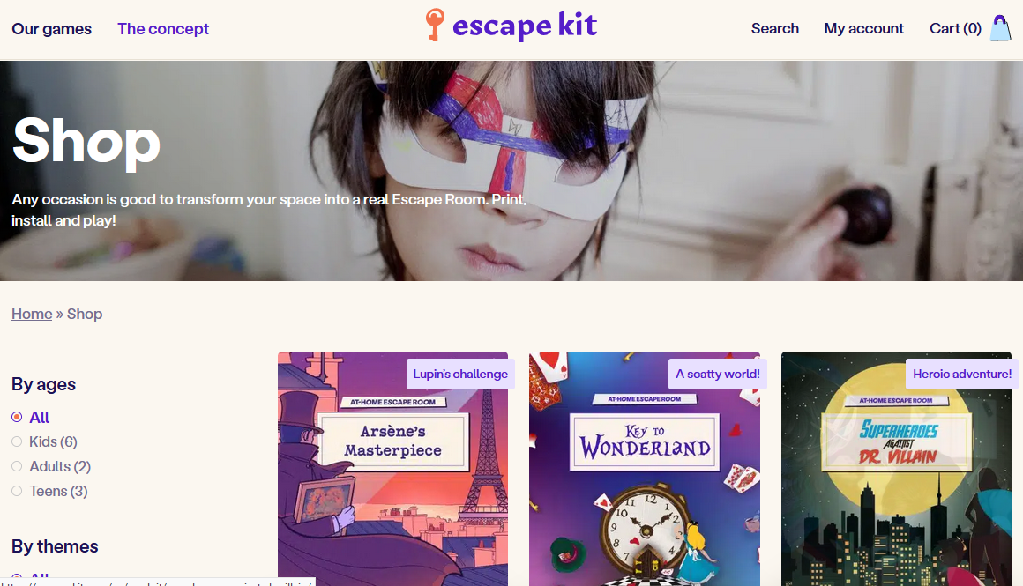
Example:
https://escape-kit.com

Slide 15
Example:
https://www.breakoutedu.com/

Slide 16
What are some reasons for an educational escape room?:
skill development, solve tasks, improve interaction
improve trainer-learner relationship, enhance performance, stimulate regulation
enhance group cohesion, skill development, support of learning processes,
support of teaching processes, enhance communication, solving riddles

Slide 17
A3: How to create an educational escape room?

Slide 18
What have developers to consider when designing an educational escape room?
User Type „User needs assessment is carried out to determine player demographic and educational needs.”
Time „Length of experience. Can be short experience of 15 minutes or a longer experience that lasts multiple days.”
Difficulty „Consideration of intended users to scale difficulty of puzzles for different levels of players such as college students, undergrads, post grads, doctorates and staff.”
Clark, S. et al. (2017): escapED: A Framework for Creating Educational Escape Rooms. In: International Journal of Serious Games. Volume 4, Issue 3, September 2017, http://dx.doi.org/10.17083/ijsg.v4i3.180

Slide 19
What have developers to consider when designing an educational escape room?
Mode „Choose mode of experience such as; Cooperation based: Players work together to solve/escape the experience vs Competitive based: Players compete to be the first to figure out the objectives.”
Scale „Choose number of participants the game is to be designed for.”
Clark, S. et al. (2017): escapED: A Framework for Creating Educational Escape Rooms. In: International Journal of Serious Games. Volume 4, Issue 3, September 2017, http://dx.doi.org/10.17083/ijsg.v4i3.180

Slide 20
The Star-Model
Game elements:
the narrative = Story
the game-flow
the puzzles and
the equipment
Botturi /Babazadeh p. 45
Botturi, L. / Babazadeh, M. (2020): Designing educational escape rooms: validating the Star Model. In: International Journal of Serious Games, Vol. 7, Issue 3, September 2020, http://dx.doi.org/10.17083/ijsg.v7i3.367

Slide 21
Puzzle structures in escape rooms:
1. basic structures: open, sequential and path-based Squares are puzzles and rectangles are meta-puzzles
sequential
path-based
open
Nicholson, S. (2015). Peeking behind the locked door: A survey of escape room facilities.
White Paper available at http://scottnicholson.com/pubs/erfacwhite.pdf, p. 17

Slide 22
Puzzle structures in escape rooms:
2. a complex, hybrid structure, such as a pyramid.
Nicholson, S. (2015). Peeking behind the locked door: A survey of escape room facilities.
White Paper available at http://scottnicholson.com/pubs/erfacwhite.pdf, p.18

Slide 23
What are the game elements of an educational escape room?:
collaboration, game-flow, riddles and communication
collaboration, narratives, game-flow and puzzles
narrative, game-flow, puzzles and equipment
narrative, riddles, roles and equipment
roles, puzzles, immersion and communication

Slide 24
A4: The role of the teacher/trainer

Slide 25
Role of teachers/trainers
1. Design or selection of the escape room
2. Game master
3. Providing start information
4. Providing hints
5. Debriefing

Slide 26
Own educational escape rooms
For own educational escape rooms you can easily use a) a website e.g. designed with WordPress, b) ZOOM or another conferencing tool where you an display a presentation c) Google Forms or google slides

Slide 27
Educational escape room design steps
“Choose a topic
Choose an end goal (the big problem to solve — using the breadcrumbs from the small puzzles)
Set the scene
Decide on topics of the small puzzles that participants will solve (and the breadcrumbs they will earn by solving them)
Create the small puzzles
Create answer sheets and/or answer keys”
Learning Hypothesis (2023): https://learninghypothesis.com/how-to-create-a-digital-escape-room/

Slide 28
B. Training phase
work session in small groups

Slide 29
Task 1
Write down an idea for a story of an escape room with regard to your subject.
You have 20 minutes. Please, collaborate with another person.
Afterwards, everyone should share ideas.

Slide 30
Task 2
Have a look at https://teambuilding.com/blog/virtual-escape-rooms and have a look at different digital escape rooms for team building. Write down the idea, the story and core elements of one of it.
You have 45 minutes. Please work on your own.
Afterwards, everyone should share the impressions on the basis what you all wrote down.

Slide 31
Congratulation!
You mastered module C on digital educational escape rooms!

